Slide 1
CHAPTER 1
WELCOME
TO WEB DESIGN

Slide 2




Web design Evaluation
CHAPTER 2
July
November
ENCODING
INFORMATION
17 Weeks
10%
15%
30%
45%

Slide 3

OBJECTIVES FOR TODAY
Why do we create web pages ?
What is a web page and what is the HTML file ?
How to display a HTML file on browser ?

Slide 4



WARM UP
10 MIN
TEAM 2
FREE DISCUSSION
Select 1 of those web site
Answer those questions
https://www.w3schools.com/
https://www.amazon.com/
https://www.unicef.org/cambodia/education
What do you think about these web sites ?
How do you feel about these web sites ?
Why companies always have a website ?
What do you expect of a website ?

Slide 5

EXPLAIN
5 MIN
CLASS
HTML is the language to create web pages
HyperText Markup Language.
You can make links
from one page to
another
HTML language
Is based on TAGS

Slide 6
EXPLORATION
You first web page
15 MIN
1
Open VSCode
Create a file page.html with following content :
<html>
<head>
<title>HTML lesson 1</title>
</head>
<body>
<h1>My first page</h1>
<p>Hello WEP 2023 students!</p>
</body>
</html>
Open this file on your web browser.

Slide 7
EXPLORATION
You first web page
15 MIN
1
Compare your code with the result on the browser and answer questions:
Where is the content of : <title>, <h1>, <p> ?
What is the meaning of : <title>, <h1>, <p> ?
Check on Google :
What is HTML language ?
What does HTML means ?

Slide 8
EXPLAIN
What is a HTML TAG ?
5 MIN
CLASS
<title> HTML lesson 1 </title>
Start tag
End tag
Tags tell the browser about the structure of your HTML

Slide 9
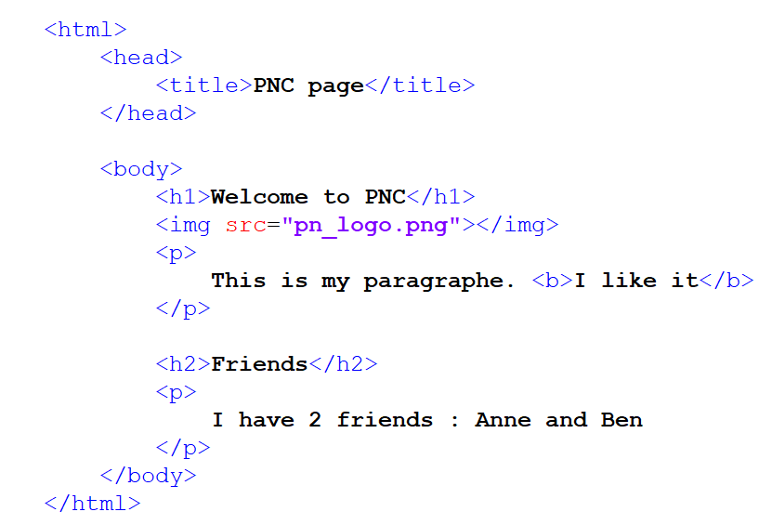


PRACTICE
Draw the final result on your book
10 MIN
1
Write it on paper
pn_logo.png

Slide 10
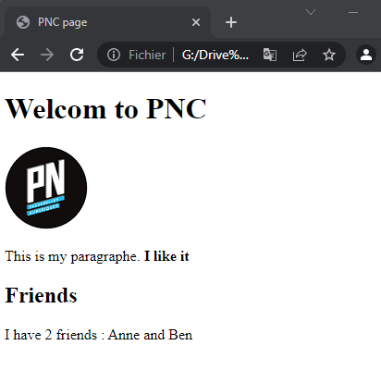
DISCUSS
What is the meaning of each tag?
CLASS
1
1
2
2
3
4
3
5
4
5

Slide 11


HOMEWORK
INDIV
After class
1. Complete the handout I give you now.
2. Do the required homework
3. Send your homework to Google Classroom

